Slide 1
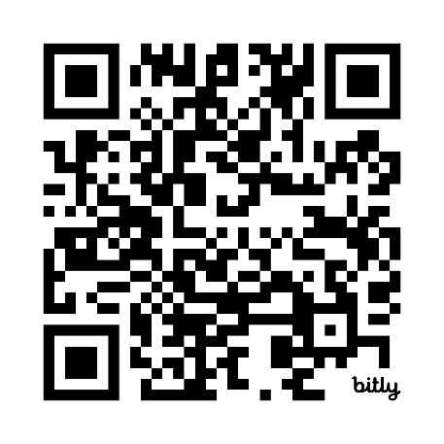

OPPORTUNITIES FOR WELLNESS CREDITS THROUGH FERRARA BENEFIT PLANS
Enrolled in a Ferrara Health Plan?
Receive a 2026 Wellness Credit for Completing Your Annual Physical
Enrolled in Accident* / Critical Illness / Hospital Indemnity Insurance through VOYA?
Enrolled in Blue Cross and Blue Shield of IL
If you are covered under a VOYA benefit and have completed a health screening test such as a blood test, eye exam, vaccine, or other covered test, make sure you file your wellness benefit to earn $50 cash.
Complete your annual physical and save up to $600 annually on Medical Plan contributions! No further action is required on your part once you complete your physical. Ferrara will be informed by BlueCross that you’ve completed your physical and apply the credit to your medical deduction. There is generally a 45-60 day delay from the time you have a physical until you see the credit reflected on your Medical payroll deduction.
With claim coordination though BCBS simply click on the link to apply EBRC - Ferrara Candy Corporation You can file wellness benefit claims for any covered dependents and receive benefits for all three of these insurance plans. For Kaiser plans file your claim using the QR code here or call 877-236-7564.
Enrolled in Kaiser (CA residents only)
* HDHP1/HDHP2 plan members are automatically enrolled in the Accident Plan
If you received a physical within the last year, please contact the Total Rewards team at TotalRewards@ferrara.com for more information on submitting documentation of your physical.

